Slide 1


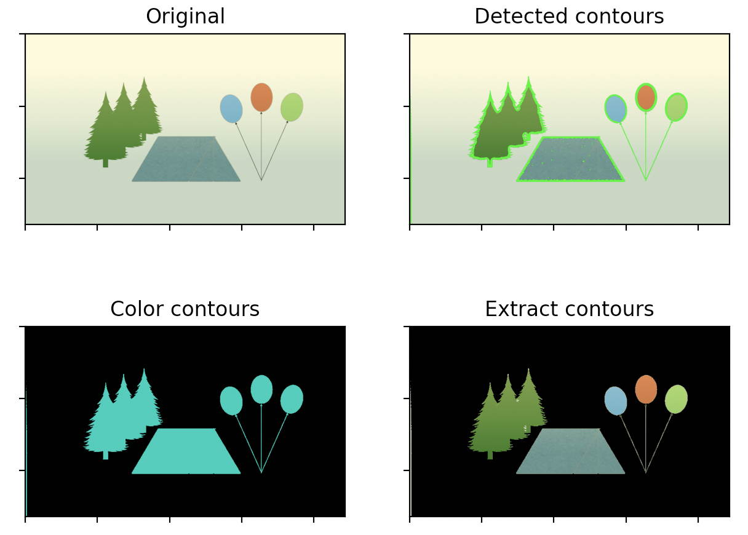

Session 5 :
Introduction to Contour Detection

Slide 2

Introduction
Contour detection is used to find object outlines and analyze shapes.
It is essential in object recognition, tracking, and scene analysis.

Slide 3
Learning Outcome
Learn how to detect and analyze shapes in images using contour extraction.
Develop understanding of shape-based processing.

Slide 4
Python Programming Task Overview
Write a script using OpenCV to detect and draw contours around image objects.
Use methods like cv2.findContours and cv2.drawContours.

Slide 5
Why It Matters
Contours help in shape recognition, segmentation, and motion analysis.
Applications:
- Microscopy: Cell detection
- Finance: Coin recognition

Slide 6
Python Code : Real-World Example
Scenario 1: Detecting cells in biological research.
Scenario 2: Identifying coins or defects on production lines.

Slide 7
Understanding Contours
Contours are curves joining continuous points of the same intensity.
They define the edges of shapes and can be used for object boundaries.

Slide 8
Finding Contours with OpenCV
Use: cv2.findContours(binary_image, mode, method)
Apply after thresholding or edge detection for better results.

Slide 9
Drawing Contours
Use: cv2.drawContours(image, contours, index, color, thickness)
Visualize shapes on the original or a blank canvas.

Slide 10
Filtering Contours by Area
Use: cv2.contourArea(contour)
Filter out noise and focus on significant shapes based on area or perimeter.

Slide 11
Analyzing Contour Properties
Use OpenCV to compute centroid, bounding box, aspect ratio, etc.
These features are valuable for classification or tracking.

Slide 12
Python Code:
Contour Detection
📝 Project Title: Contour-Based Object Analysis with Properties
🎯 Objective:
Detect object contours, compute geometric properties, and annotate them on the image.
📚 Key Concepts:
- Contour extraction
- Area and perimeter measurement
- Text annotation using OpenCV

Slide 13
Image Preparation & Contour Detection
🔹 Image Preparation:
- Load color image using cv2.imread()
- Convert to grayscale (cv2.cvtColor)
- Apply binary thresholding with cv2.threshold()
🔹 Contour Detection:
- Use cv2.findContours with cv2.RETR_EXTERNAL
- Simplify contours using cv2.CHAIN_APPROX_SIMPLE

Slide 14
Contour Properties Calculation
📐 Area & Perimeter:
- Area: cv2.contourArea(contour)
- Perimeter: cv2.arcLength(contour, True)
- Filter out noise: Skip contours with area < 100
📍 Moments Calculation:
- Use cv2.moments to find centroid (cx, cy)
- Ensures accurate placement of annotations

Slide 15
Annotation and Visualization
🎨 Draw & Label Contours:
- Draw with cv2.drawContours (green, thickness=2)
- Annotate with cv2.putText at centroid
- Format: Area and Perimeter (A:x P:y)
🖼️ Display:
- Show image using cv2.imshow
- Exit the viewer on pressing 'q'

Slide 16
Python Script :Code Summary
Main Functions:
- cv2.imread, cv2.cvtColor, cv2.threshold
- cv2.findContours, cv2.contourArea, cv2.arcLength
- cv2.moments, cv2.drawContours, cv2.putText
💡 Tip: Use area filtering and moments for clean annotations!

Slide 17

Python Script on Contour Detection
PART 1
import cv2
import numpy as np
image = cv2.imread('image.jpg')
if image is None:
raise ValueError("Image not found!")
gray = cv2.cvtColor(image, cv2.COLOR_BGR2GRAY)
_, binary = cv2.threshold(gray, 127, 255, cv2.THRESH_BINARY)
contours, _ = cv2.findContours(binary, cv2.RETR_EXTERNAL, cv2.CHAIN_APPROX_SIMPLE)

Slide 18
Python Script on Contour Detection
PART 2
for contour in contours:
area = cv2.contourArea(contour)
if area < 100:
continue
perimeter = cv2.arcLength(contour, True)
M = cv2.moments(contour)
cx = int(M['m10'] / M['m00']) if M['m00'] != 0 else 0
cy = int(M['m01'] / M['m00']) if M['m00'] != 0 else 0
cv2.drawContours(image, [contour], -1, (0, 255, 0), 2)
cv2.putText(image, f"A:{int(area)} P:{int(perimeter)}", (cx, cy), cv2.FONT_HERSHEY_SIMPLEX, 0.5, (255, 0, 0), 1)

Slide 19
Python Script on Contour Detection
PART 3
cv2.imshow('Contours with Properties', image)
cv2.waitKey(0)
cv2.destroyAllWindows()

Slide 20
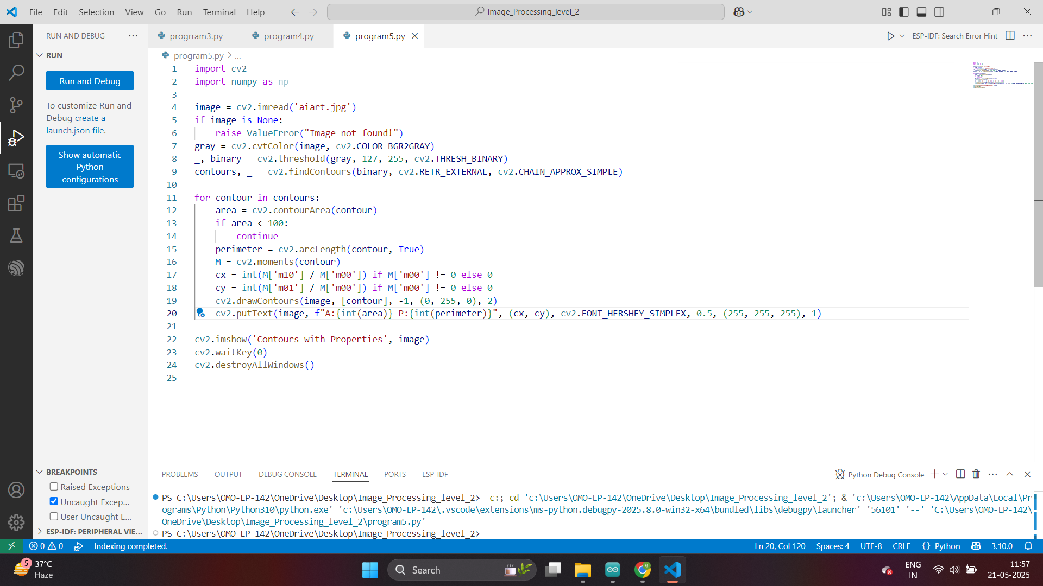

Slide 21
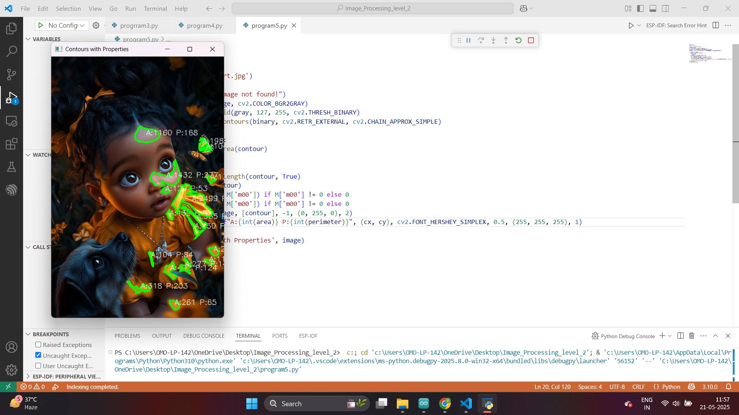

Slide 22
Python Script
Results
Video
Detailing
Various
Scenarios

Slide 23
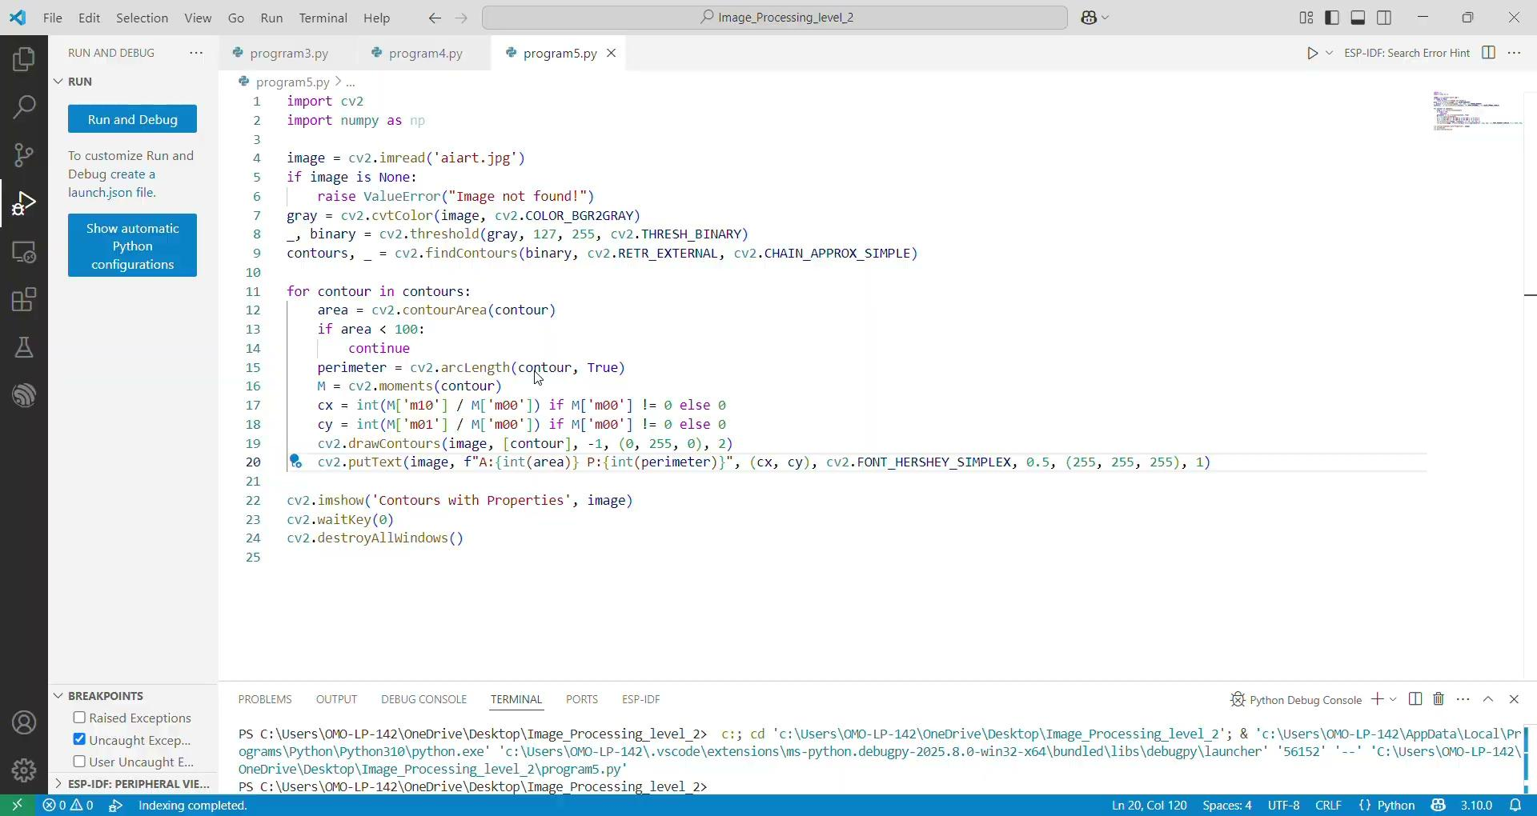

Slide 24
Exercise
1. What is the primary purpose of contour detection in image processing?
A. Changing image brightness B. Finding object outlines and analyzing shapes C. Enhancing image contrast D. Reducing noise in images
Correct Answer: B
2. Which OpenCV function is used to detect contours in a binary image?
A. cv2.drawContours() B. cv2.threshold() C. cv2.findContours() D. cv2.contourArea()
Correct Answer: C

Slide 25
Exercise
3. Before applying cv2.findContours(), which preprocessing step is typically required?
A. Convert to grayscale only B. Apply edge detection only C. Thresholding or edge detection D. Apply Gaussian blur
Correct Answer: C
4. What mode in cv2.findContours() is used to detect only the outer contours?
A. cv2.RETR_TREE B. cv2.RETR_LIST C. cv2.RETR_CCOMP D. cv2.RETR_EXTERNAL
Correct Answer: D

Slide 26
Exercise
5. Which OpenCV function is used to draw contours on an image?
A. cv2.drawContours() B. cv2.contourArea() C. cv2.moments() D. cv2.arcLength()
Correct Answer: A
6. What property is calculated using cv2.contourArea()?
A. Perimeter B. Threshold value C. Image brightness D. Area of the contour
Correct Answer: D

Slide 27
Exercise
7. What function is used to calculate the perimeter of a contour?
A. cv2.threshold() B. cv2.arcLength() C. cv2.imshow() D. cv2.resize()
Correct Answer: B
8. What is the use of cv2.moments() in contour analysis?
A. Drawing contours B. Calculating area only C. Computing centroid for annotation D. Applying filters
Correct Answer: C

Slide 28
Exercise
9. Which function is used to annotate contour area and perimeter on the image?
A. cv2.drawContours() B. cv2.imshow() C. cv2.putText() D. cv2.copyTo()
Correct Answer: C
10. Why should contours with area < 100 be filtered out in analysis?
A. To increase image contrast B. To improve the threshold value C. To remove noise and focus on significant shapes D. To optimize the resolution
Correct Answer: C

